Slide 1
Office 365 Accessibility Features
Karen McCall, M.Ed.
Karlen Communications
Copyright 2018

Slide 2
Overview
This webinar provides an overview of new, almost new and “I didn’t know that existed” tools in Office 365/Office 2016.
As accessibility updates are being rolled out continuously, having the subscription to Office 365 ensures that you have access to the latest tools for accessibility for document authors and those of us with disabilities.

Slide 3
Review of Existing Tools
Almost new and “I didn’t know you could do that!”

Slide 4
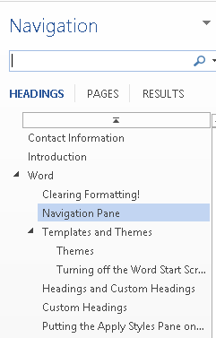
Navigation Pane in Word
View Ribbon, Navigation Pane.
Alt + W, K.
Lets you see a “list of Headings” in a document much like those who use screen readers or Text-to-Speech tools do.
Lets you check the sequential order of Headings to make sure you don’t skip a level.

Slide 5
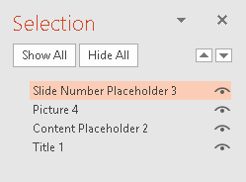
Selection Pane in PowerPoint
Home Ribbon, Select, Selection Pane.
Alt + H,
Lets you order objects on a slide so that they are in a logical reading order.
Important to note that in the Selection Pane you have the first object you Tab to at the bottom.
Must work from the bottom up, not top down.

Slide 6
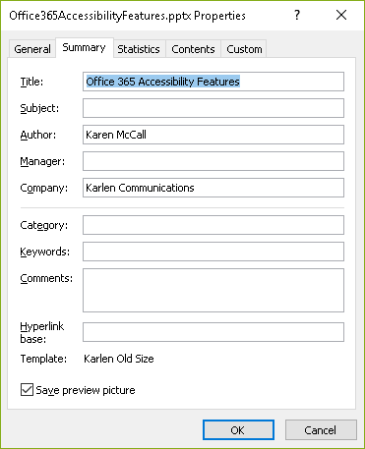
Document Properties
File/Backstage area, Info tab, Properties, Advanced Properties.
If you fill in the document title in the Info tab it does not get converted to the document title in a tagged PDF document.
You have to use the Advanced Properties dialog.
Alt + F, letter I, Q, S then Enter.
In PowerPoint it snags the title from the first slide Title Placeholder, in Word it does not.

Slide 7
Accessibility Checkers
Review Ribbon, Check Accessibility:
Alt + R, A, number 1.
File/Backstage area, Info tab, Inspect Document, Check Accessibility.
Alt + F, letter I, letter I, then Down Arrow once and press Enter on Check Accessibility.
The rules for the accessibility checker conform to WCAG 2.0.
Three types of problems:
Errors, Warnings and Tips.
As you make a repair that problem is removed from the list of found items in the accessibility checker.

Slide 8
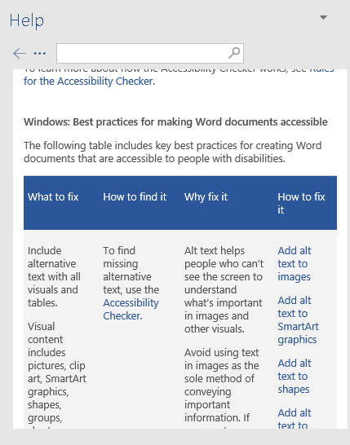
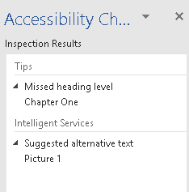
Accessibility Checker Visualized

Slide 9
Unlink Fields
For academic papers and other publications where you don’t want the links to be active.
Select the link/field and press Ctrl + Shift + F9.
Add “Unlink Fields” to the Quick Access Toolbar.
File/Backstage, Options, Quick Access Toolbar.
Choose Commands not in the Ribbons.
Press U for Unlink Fields.
Once you find it, add it to the Quick Access Toolbar by pressing Alt + A.
It will be placed at the end of the list of tools in the Quick Access Toolbar.
The keyboard command to use it will be Alt followed by a number.

Slide 10
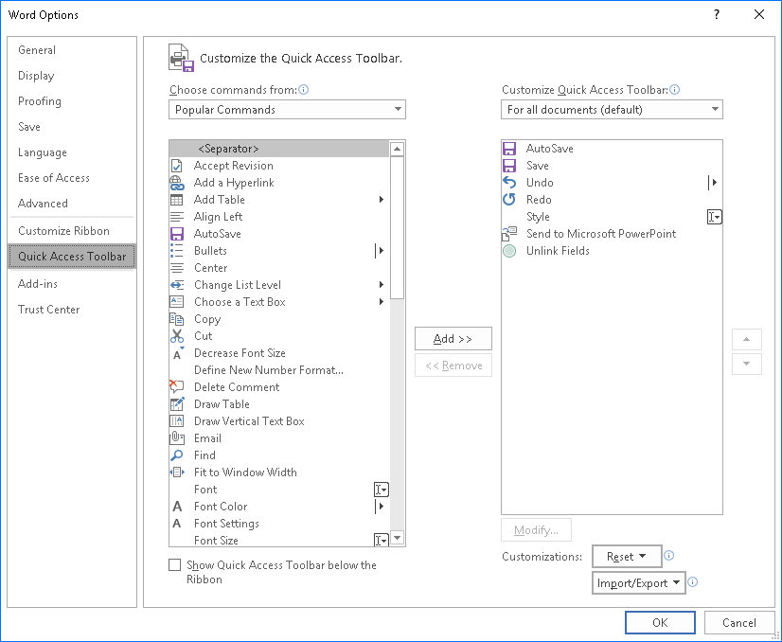
Quick Access Toolbar – Unlink Fields

Slide 11
New Tools/Features
What are some of the new tools you might not know about…or recently added tools you may have come across?

Slide 12
Intelligent Services
Intelligent services include Translate, Design Services and
Design Services do not integrate with your slide template or Theme.
Is not usable when working in Slide Master view, only Normal view.
Images still need Alt Text.
Is helpful for those of us with no graphic design sense. ☺

Slide 13
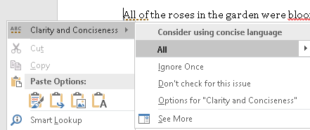
Concise Language Support
If you right click on a misspelled word or if you use Alt + F7 to spell check, there is additional information for the suggestions if you have Intelligent Services turned on.

Slide 14
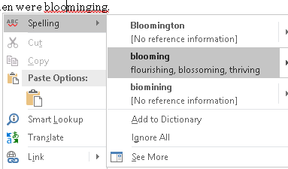
Spell Check Support
If you right click on a misspelled word or if you use Alt + F7 to spell check, there is additional information for the suggestions if you have Intelligent Services turned on.
Activating “More” opens the Spell check Pane.

Slide 15
PowerPoint Designer
File/Backstage area, Options, General tab and then PowerPoint Designer
Provides a variety of ways to use images on slides.
Cannot be used on a Slide Master at this time.
Will need to give the images Alt text.
Lets you just add the images and choose a layout.
For those of us who have no sense of graphic design. ☺

Slide 16
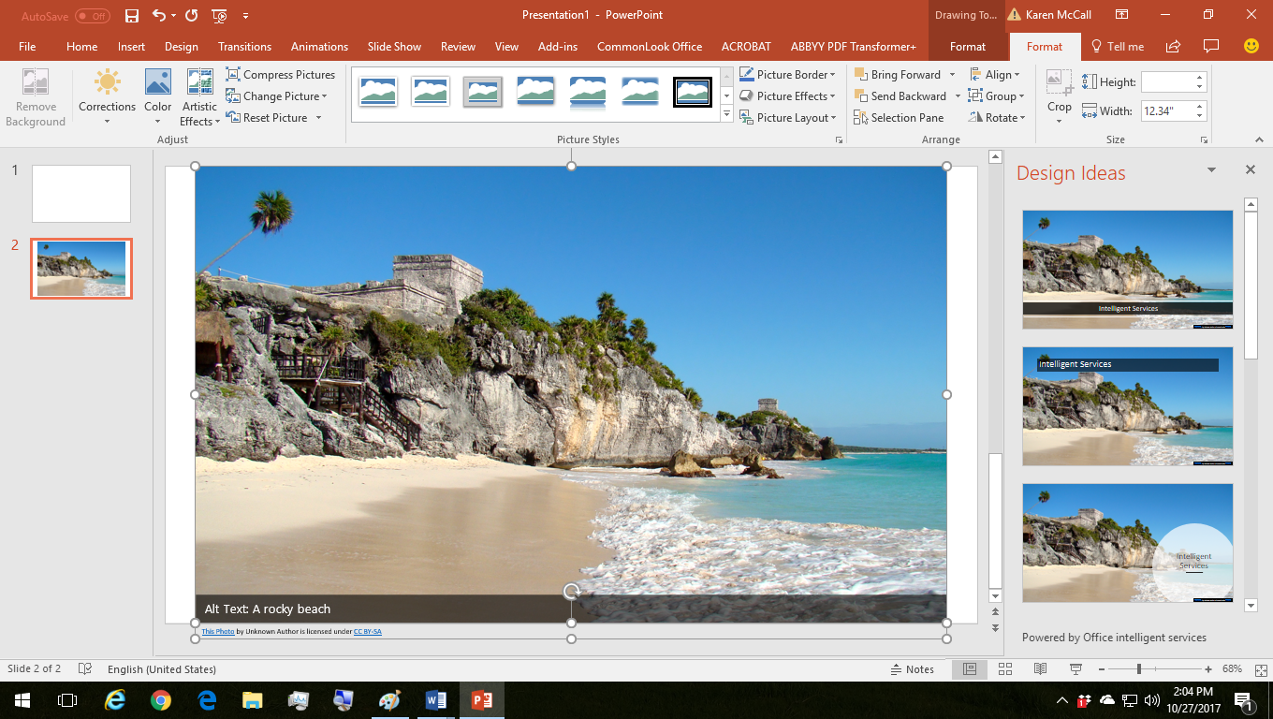
PowerPoint Designer Sample 1

Slide 17
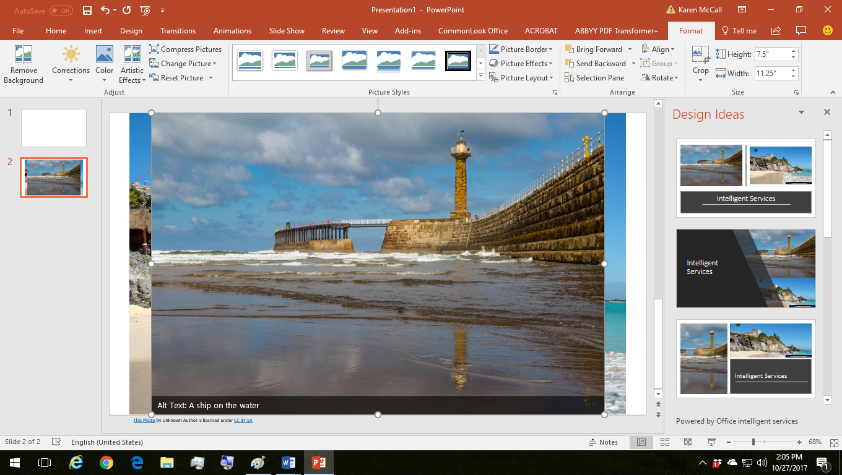
PowerPoint Designer Sample 2

Slide 18
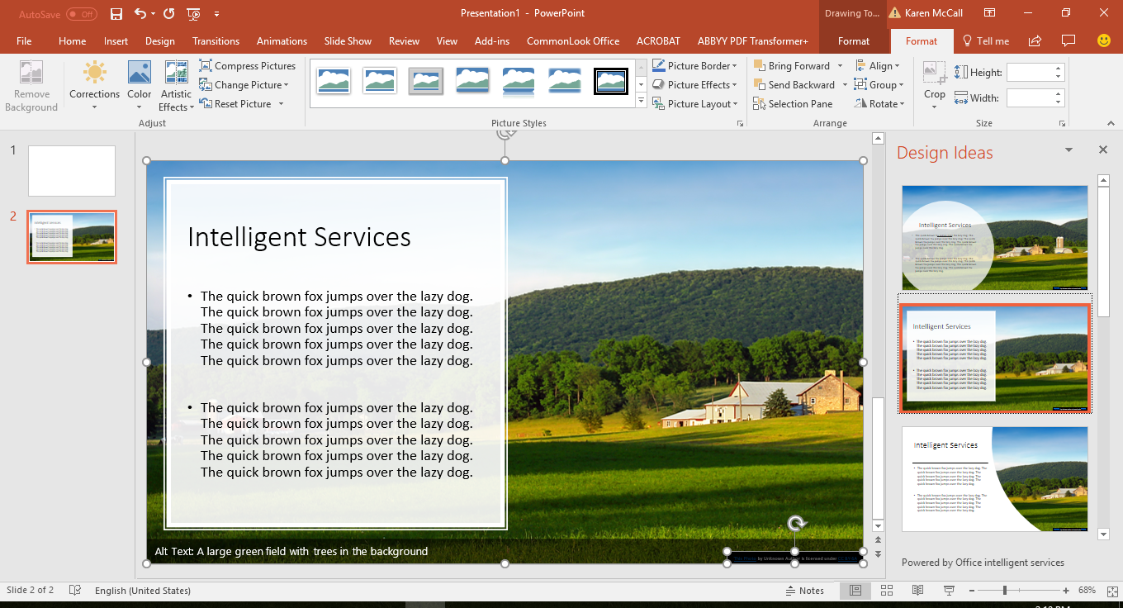
PowerPoint Designer Sample 3

Slide 19
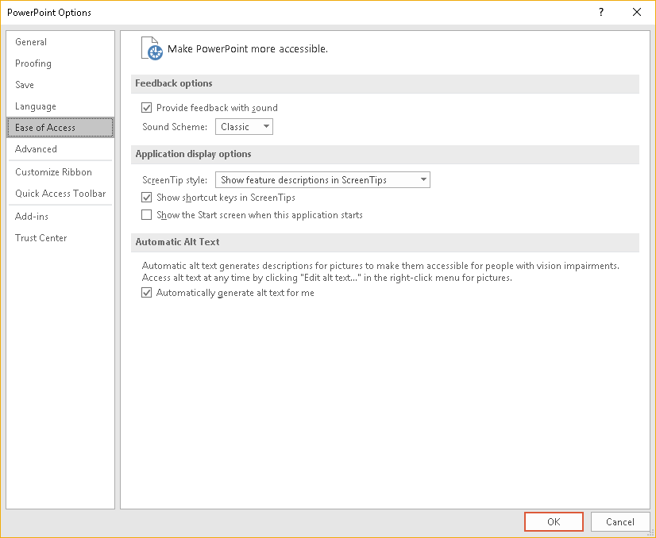
Automatically Generate Alt Text
File/Backstage area, Options, Ease of Access, Automatic Alt Text.
Alt + F, T, E, Tab or Shift Tab…it is the last check box.
The Alt text is machine generated and is capable of learning.

Slide 20
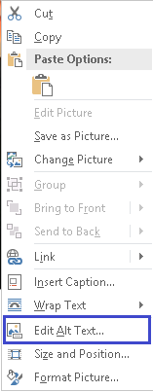
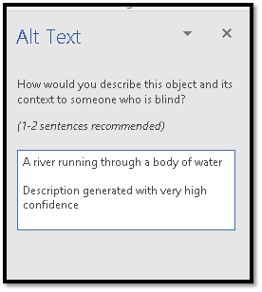
Automatic Alt Text Example

Slide 21
Word - Windows
There is a faster way to add Alt Text to images in your documents.
Right click on the image or press the AppKey.
Press A for click on Edit Alt text.
Focus should go immediately to the Description field in the Alt text Pane where you can add the Alt Text.
Note: So far, this doesn’t seem to synchronize with the Alt text attributes in the Format Picture Pane.
There are accessible templates for Word.
Table Headers now tagged correctly from Word.
Still use the Header row Repeat, however, you can now go to the Table Tools, Design Ribbon and make sure that the First Column and Title Tow are checked.
Researcher – References, Researcher (Alt + S, R, R)

Slide 22
Word - Mac
We’ve had the ability to save a Word document as a tagged PDF from Word for Mac for just over a year now.
It is a secure service.
Has the Accessibility Checker.
Researcher – Research Pane with suggestions for citations.
Look under the References Ribbon.

Slide 23
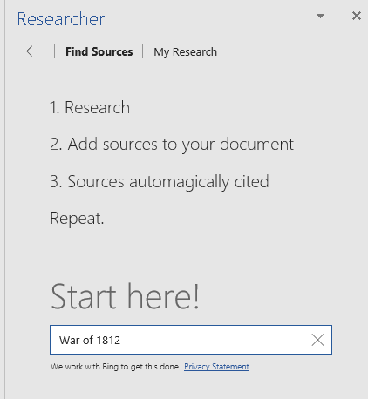
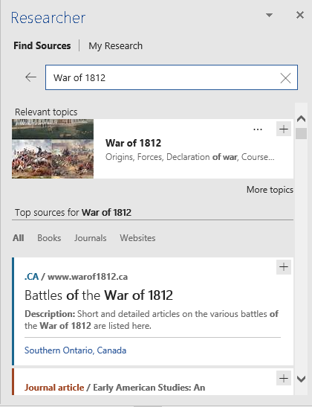
Researcher

Slide 24
PowerPoint
PowerPoint Presenter.
Lets you provide caption and translate your presentation.
Is an add-in.
Use the same process for adding Alt Text, right click or press the AppKey then press A or click on the Edit Alt Text option.
Microsoft Sway was designed for short marketing presentations, not as a substitute for PowerPoint.
There is a setting for accessible Sway presentations.
There are accessible templates for PowerPoint.
Make sure that they are accessible and don’t use all caps or have colour contrast issues.
Works better with your own high contrast settings.
Table Headers (column and row titles now tagged correctly.)
Change the language of a presentation: go to Outline View, Select Alt then Review Ribbon, Language, Set Proofing Language.

Slide 25
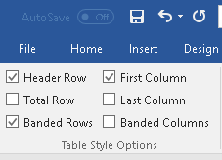
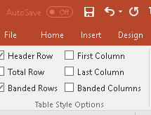
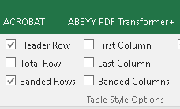
Table Headers in Office and Tagged PDF.
In Word, still have the Header Row Repeat, however, this is no longer the trigger for identifying Table Headers in a tagged PDF document.
Table Tools, Design Ribbon, and make sure the check box for First Column and Title Row are checked.
In PowerPoint and Excel you need to check the check box for First Column.
Word: Alt + J, T, A for Header Row and M for First Column.
PowerPoint: Alt + J, letter O for Header Row and M for First Column.
Excel: Alt + J, letter O for Header Row and C for First Column.

Slide 26
iOS Apps
Office Lens – works with OneNote to let you take an image of a whiteboard, document or photo (3 modes)
Converts scanned documents to editable text then sent to Word.
iOS has some of the same features as the web apps or desktop apps to make your Office documents accessible.
So far, I haven’t found a way to use my own templates with the iOS apps.
For example, a Style Set for larger print or my own Normal document template.

Slide 27
Summary of New Features
Digital ink improvements for students with visual, learning or cognitive disabilities.
Resume Reading in PowerPoint. Already in Word.
Excel for iOS: new chart type to let you take geographical data and create a map.
File, Open, Shared with Me to list attachments (Alt + F, letter O, Y, 2)
Tell Me – Alt + Q to list tools by Ribbon or individually.
PowerPoint iOS: Share a Slide but it shares the slide as a picture.

Slide 28
New Features on the Horizon!
Ability to mark images as decorative
I’m not sure if this will transfer gracefully to tagged PDF or if you will need to make the images Artifacts in Adobe Acrobat.
Add the ability to check colour contrast.
Ability to more easily fix accessibility issues in the Accessibility Checker
Updating rules for the accessibility checker for WCAG 2.0.
Mac and Windows, Windows first then mac..
Alt Text – merging the fields so there is just one, instead of two.
Use the Description field in preparation for the change.

Slide 29
Immersive/Learning Tools

Slide 30
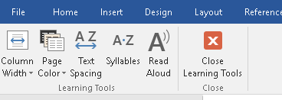
Immersive Tools in Word
Press Alt + Q and type in Learning Tools.
Press Enter on the Learning Tools item that is found.
The Learning Tools Ribbon opens and is placed at the end of the Ribbons while the document is open. You are in “Web View” of the document.
Tools are:
Column Width: Very Narrow, Narrow, Moderate and Wide.
Page Colour: None, Sepia (buff) and Inverse (White Text on Black Background).
Text Spacing:
Syllables.
Read Aloud and Close.

Slide 31
Braking Down Text by Syllables

Slide 32
Resources
Online course, books and tutorials by Karen McCall on the Karlen Communications website.

Slide 33
Microsoft Resources - 1
Office 365 Accessibility Checker
Accessible Document Templates
Office 365 Resources for People with Disabilities.
Rules for the Accessibility Checker.
What are Intelligent Services?
PowerPoint Presentation Translator.
How to use Presentation Translator in a presentation.
Learn how to Navigate Word for Mac using Accessibility Features.
Use the Accessibility Checker on your Mac to Find and Resolve Accessibility Issues.

Slide 34
Microsoft Resources – 2
What is Office Lens?
Office Lens Converts Scanned Documents to Editable Text.
iOS Best Practices for Making Your Word Documents Accessible.
Sway Accessibility.
Office Accessibility Centre.
What’s New in Office 365/Office 2016.

Slide 35
Accessible Office Documents
Accessible Word Documents.
Accessible PowerPoint Documents.
Using Microsoft Translator in a Presentation.
Accessible Excel Workbooks.
Accessible Outlook E-mail.
Learn how to Navigate OneNote using Accessibility Features.
Get Accessible Templates.
Immersive Reader.
Learning Tools for OneNote: Getting Started.

Slide 36
Styles in Word: The Online Course!
Styles in Word: A Primer for Accessible Document Design
You’ve heard of the book, now there’s an online learning course based on the book…that includes a copy of the book!
Self-paced, text, audio, video (with transcripts), sample documents and what started out to be a version of my on-site workshops has expanded to provide content on things I couldn’t fit into a day.
http://www.karlencommunications.com/Training.html

Slide 37
Styles in Word: The Book
Styles in Word: A Primer for Accessible Document Design
Haven’t heard of the book? No way!
This is a great book for both beginners and those who have been working to make Word documents more accessible for those of us with disabilities.
Get your copy of this digital tagged PDF book with the ability to print a page, topic, chapter or the entire book!
http://www.pubcom.com/about/contactus.html

Slide 38
Accessible and Usable PDF Documents
Accessible and Usable PDF Documents: Techniques for Document Authors, Fourth Edition.
First published in 2005, this edition of Karen’s book continues to provide tips, techniques and “why are we doing this” information about the accessibility of PDF documents.
If you are remediating PDF documents to be accessible, this is a “must have” for your reference library!
http://www.pubcom.com/about/contactus.html

Slide 39
Contact!
Karen McCall, M.Ed.
Karlen Communications
info@karlencommunications.com
http://www.karlencommunications.com
@KarlenInfo
Consulting and training on accessible document design (Word, PowerPoint, Excel and PDF). Advocate for a Global Inclusive Education Standard.

